Slide 1
Locals: Transforming Local Shops into Digital Storefronts
Presented by : Osama Refaat & Amr khaled
Notes:
Entered text
Slide 1: Title Slide
Title: Locals: Transforming Local Shops into Digital Storefronts
Subtitle: Empowering local businesses online
Your Name: Osama Refaat
Date: October 2024
Slide 2: Introduction
Text: Locals helps small businesses build an online presence easily, allowing them to connect with more customers and increase sales.
Slide 3: Problem Statement
Text: Local shops struggle with digital transformation, limiting their customer reach and operational hours.
Slide 4: Project Overview
Text: Locals provides a simple platform for product management, secure payments, and customer interaction 24/7.
Slide 5: Key Features
Text:
Secure login and registration.
Easy product management.
Order tracking.
Responsive design.
Slide 6: Technology Stack
Text: Locals uses Laravel, Bootstrap, MariaDB, and Apache for a secure, fast, and reliable platform.
Slide 7: Database Design (ERD)
Text: Visual representation of how the database manages users, products, and orders.
Insert ERD Image.
Slide 8: User Journey
Text:
Browsing products.
Adding items to cart.
Secure checkout.
Order tracking.
Slide 9: Challenges and Solutions
Text:
Security handled via encryption.
Optimized database queries for speed.
Slide 10: Future Roadmap
Text:
Add more payment methods.
Integrate analytics.
Expand to a mobile app.
Slide 11: Live Demo
Text: Showcase key features and how the platform works.
Slide 12: Conclusion
Text: Locals offers small businesses a simple yet powerful way to go digital and increase revenue.

Slide 2
Empowering local businesses online
Locals is a platform designed to empower local businesses by helping them establish a strong online presence. In this presentation, we will provide an overview of the Locals platform, discuss the challenges faced by local shops in digital transformation, and highlight the key features and technology stack of Locals. We will also explore the user journey, address the challenges faced during the development of the platform, discuss the future roadmap, and conclude with the benefits of Locals for small businesses.

Slide 3
Locals Platform Overview
Locals is a transformative platform that enables local shops to establish a digital storefront and reach a wider customer base. By leveraging the power of technology, Locals helps businesses connect with more customers, increase sales, and thrive in the digital era. With an easy-to-use interface and robust features, Locals provides a seamless experience for both businesses and customers.

Slide 4
Problem Statement: Challenges Faced by Local Shops in Digital Transformation
Local shops often face significant challenges when it comes to digital transformation. These challenges include limited customer reach, restricted operational hours, and a lack of technological expertise. Many local businesses struggle to establish an effective online presence, resulting in missed opportunities for growth and increased revenue. Locals aims to address these challenges and provide a solution that empowers local businesses in the digital landscape.

Slide 5

Locals' Solution for Online Presence and Customer Interaction
Locals provides local shops with an easy way to establish an online presence. It enables businesses to showcase products, manage inventory, and connect with customers efficiently. With Locals, shops can expand their reach, operate 24/7, and offer a smooth online shopping experience.

Slide 6
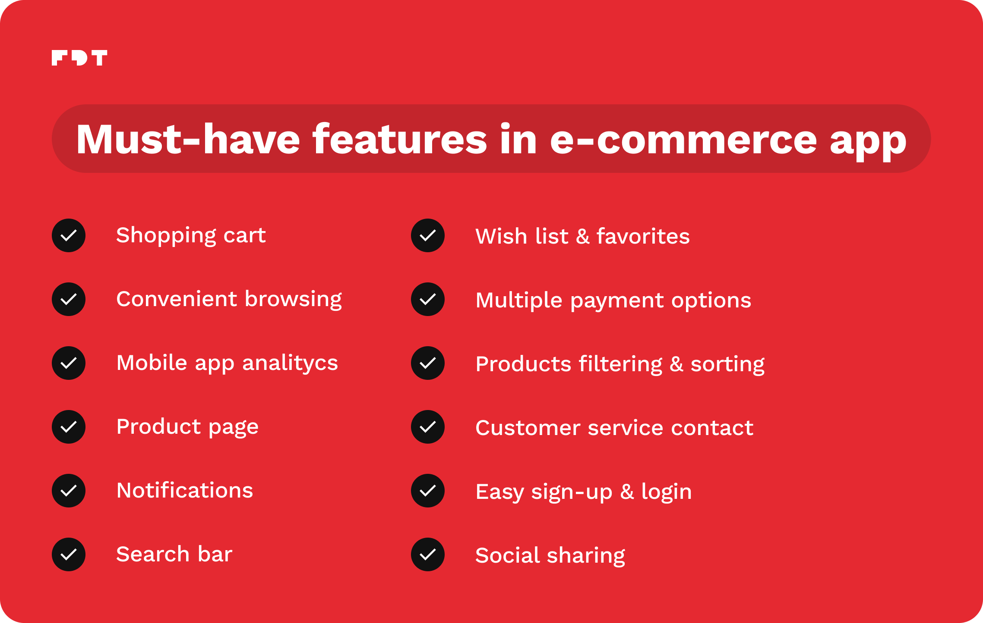
Key Features of Locals Platform
Locals offers a range of key features that enable local businesses to maximize their online presence and customer interaction. These features include:
Secure Login and Registration: Locals ensures the security of user accounts through secure login and registration processes. This helps protect sensitive customer information and build trust among users.
Easy Product Management: With Locals, businesses can easily manage their product catalog, including adding new products, and organizing items into categories. This simplifies the process of showcasing and selling products online.
Responsive Design: The Locals platform is designed to be responsive, ensuring a seamless user experience across different devices and screen sizes. This enables customers to browse and shop conveniently, whether they are using a desktop computer, tablet, or smartphone.

Slide 7

Technology Stack of Locals Platform
Locals is built on a robust technology stack to ensure a secure, fast, and reliable platform for local businesses. The stack includes:
Laravel: A powerful PHP framework that forms the backbone of the application, providing built-in security and scalability.
Blade: Laravel’s templating engine, which allows for clean and efficient rendering of dynamic content.
Laravel Breeze: A lightweight starter kit for authentication, providing user login and registration features.
Node.js: Used for managing dependencies and development tools, particularly for compiling assets like JavaScript and CSS.
Bootstrap: A front-end framework for creating responsive and mobile-friendly designs.
MariaDB: An open-source relational database for fast and efficient data management.
HTML5, CSS3, JS: Core web technologies that power the structure, style, and interactivity of the platform.

Slide 8
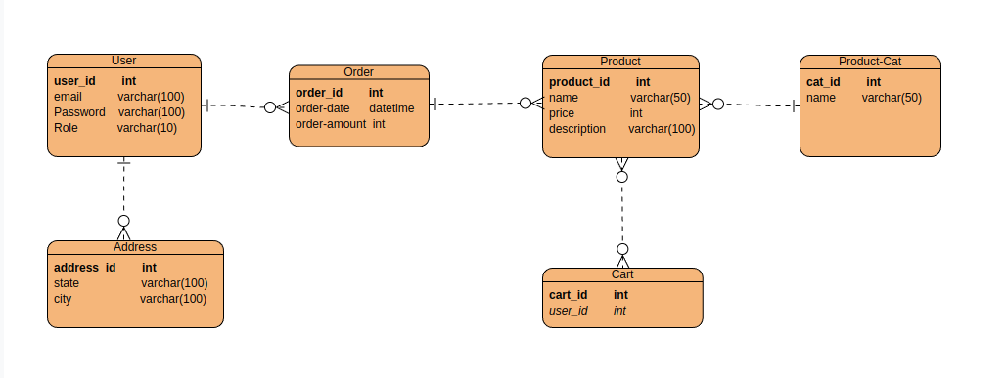
Visual Representation of the Database Schema
The database design of Locals follows an Entity-Relationship Diagram (ERD) approach. This visual representation showcases how the database manages users, products, and orders. With an efficient and well-structured database schema, Locals ensures seamless data management and retrieval.

Slide 9
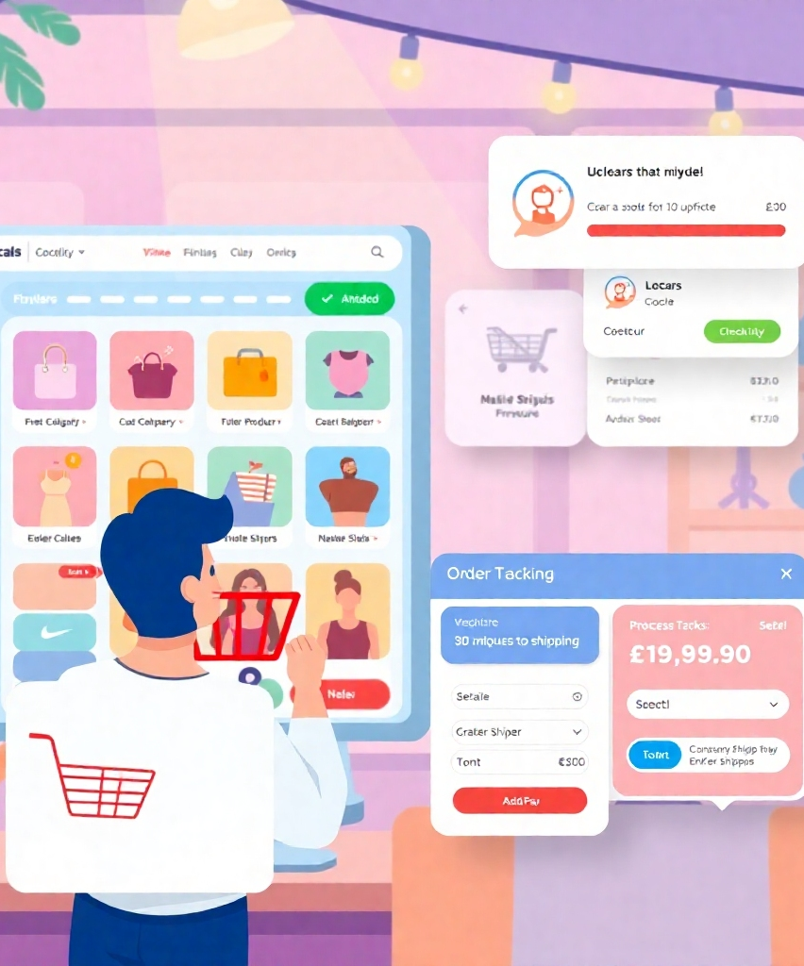
User Journey through Locals Platform
The user journey through the Locals platform involves several key steps:
Browsing Products: Customers can easily browse through the available products on the Locals platform, exploring different categories and filtering options to find their desired items.
Adding Items to Cart: Once customers find products they want to purchase, they can add them to their shopping cart, which keeps track of their selected items until they are ready to proceed to checkout.
Secure Checkout: Locals provides a secure checkout process, allowing customers to review their order, enter their shipping details, and complete the purchase with confidence.

Slide 10
Challenges Faced and Solutions Implemented by Locals Platform
Security Measures and Encryption
Optimized Database Queries for Speed
To protect user data and defend against security threats, Locals employs strong security measures such as password hashing, user authentication, secure communication protocols, and regular security audits.
To enhance performance and responsiveness, Locals employs caching techniques to optimize query execution time and improve the overall speed of the platform.

Slide 11

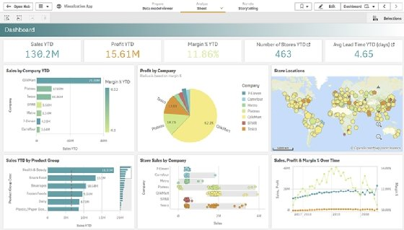
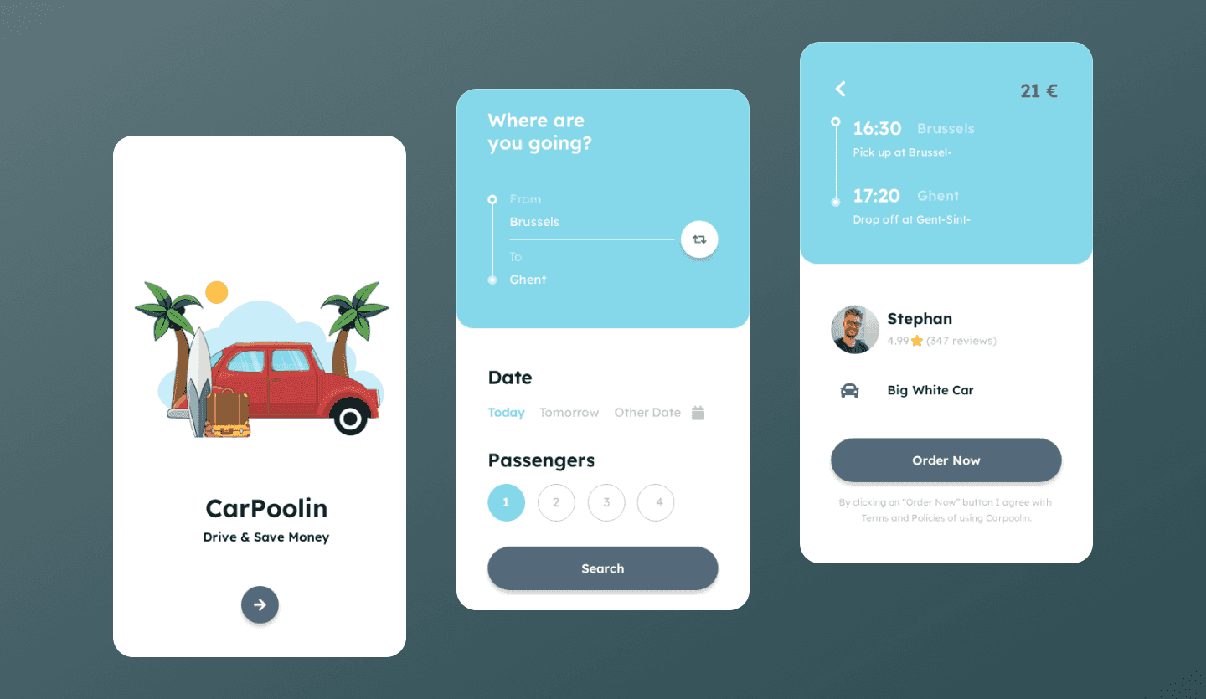
Future Roadmap for Locals Platform
Addition of More Payment Methods
Integration of Analytics
Expansion to a Mobile App
To cater to diverse customer preferences, Locals plans to integrate additional payment methods, making it easier for customers to complete their purchases.
Locals aims to provide businesses with powerful analytics tools, enabling them to gain valuable insights into customer behavior, sales trends, and other key metrics to inform their business strategies.
Recognizing the growing importance of mobile commerce, Locals plans to expand its platform to include a dedicated mobile app, enhancing convenience and accessibility for both businesses and customers.

Slide 12

Showcase of Key Features and Platform Functionality
In this live demo, we will showcase the key features and functionality of the Locals platform. We will explore the user interface, demonstrate how businesses can manage their products, and show the seamless checkout process. This demo will provide a hands-on experience of the power and potential of Locals for local businesses.

Slide 13

Locals as a Powerful Tool for Small Businesses to Go Digital and Boost Revenue
In conclusion, Locals offers small businesses a simple yet powerful tool to transform their operations and establish a strong online presence. By leveraging the platform's key features, local shops can overcome the challenges of digital transformation, connect with more customers, and ultimately boost their revenue. Locals represents a significant opportunity for small businesses to thrive in the digital age and ensure long-term success.

